Slide 1
POLICY OPTIONS FOR GENUINE FINANCIAL REFORM
Tarek El Diwany
Istanbul, 12 September 2013
Speaker notes are included in this version. Choose View >> Notes Page

Slide 2
Some Theology
What is our purpose?
To whom are we accountable?
How should we measure success?
How should we regulate?
Notes:
When designing economic and social policies we first need to define our purpose. Is it profit maximization? What about the maximization of happiness, social stability, or environmental sustainability? Muslims don’t worship money, so why should we make it our purpose?
If money is not our purpose, can it be the right measure of success? Is GDP the correct measure of success of a country? Is profit the correct measure of success of a nation? Is wealth the correct measure of success of a person? In Islam, good deeds and piety are the only currency on the Day of Judgment. Choose the wrong metric, and one can easily adopt the wrong policies.
Are we accountable to the financial regulator or to God? Is the financial regulator all-seeing? Doesn’t a belief in an all-seeing God change human behaviour? Do we place too much emphasis on academic performance when recruiting? Have our human resources departments assumed that people with good university grades are also good at being ethical? The heart is the steering wheel, and the brain is the engine. A powerful engine with a malfunctioning steering wheel can cause major disasters. The recent financial crisis is one such disaster.
More external rules are not the answer to our financial crisis. The banks and other financial institutions, along with their lawyers and lobbyists, will most likely find a way around the new rules if they are not ethically aligned to them. What is needed is more internal regulation. We need better human governance. Corporate governance misses the point. Corporations are staffed by human beings. We need to promote new education and recruitment processes that give more focus to ethics, morality, and most of all, purpose.

Slide 3
Wealth Creation versus Wealth Transfer
 | Wealth Creation | Wealth Transfer
For personal gain | Trade Investment partnership Waged labour | Theft Interest-bearing loan Gambling Debasement
Not for personal gain | Community work Caring Educating one’s family | Gift Endowment Interest-free loan
Notes:
Two methods of enrichment are wealth creation and wealth transfer. These are motivated either by personal worldly gain (for example, to make oneself richer or more powerful) or by something other than this (for example, a reward in the afterlife). The above table shows the intersection of these two types of motivation and the two ways of acquiring wealth. Islam generally permits everything shown here except wealth transfer for personal worldly gain. The manufacture of something in return for a wage is an example of wealth creation for personal worldly gain and is permitted, while theft involves the transfer of wealth from the victim for the benefit of the thief and is prohibited. The more a society engages in this kind of activity, the lower its quality of life will be.
Wealth creation is essential in order to satisfy the needs of society (for example, roads must be repaired and food must be produced). Wealth creation not for personal gain is an essential component of overall wealth creation and government policy should aim to support it. Educating one’s children at home is a form of wealth creation which parents often undertake for little or no personal reward, and it is essential for the moral and productive capacity of society. If mothers are forced to work to supplement household income, an increase in employment income will appear in GDP statistics, but the loss of wealth creation from home education will not be measured. Likewise, the gift economy has played a historically important part in meeting the needs of Muslim society but is today only a small part of economic activity. Institutions that promote and apply zakah, waqf and other forms of sadaqah, should be supported so that they can play a part in providing the essential infrastructure of Muslim society. Projects financed from charitable sources experience a small fraction of the financing cost of projects financed from commercial sources.
In modern times, usury and debasement are two of the most powerful forces of wealth transfer for personal gain. Their acceptance by society has substantially affected the institutional structure of the economy. For example, the widespread presence of commercial banks is a consequence of the acceptance of usury and debasement of the money supply.

Slide 4
DISCOUNTING AND THE ENVIRONMENT
Given the following two forecasts, which method should be adopted under standard discounted cash-flow analysis using an annual interest rate of 10%?
Normal farming produces 100 profit per year for ever
Intensive farming produces 150 profit per year for 15 years followed
by desertification
Notes:
Standard discounted cash flow (DCF) analysis incentivises the farmer to desertify his land (here the high intensity option is chosen). Any tool that produces such a result must have something wrong with it. It is the common use of interest-based debt financing that makes DCF analysis so widespread. The fact that Islamic banks use fixed rate debt financing so heavily in their product range, suggests that Islamic banking is creating equally unsustainable trends within the economy.
In a financial system based upon profit sharing, a financial rate of return is not imposed upon a project, but rather the project determines the financial rate of return. Profit-sharing will relieve much of the pressure for unsustainable forms of business activity.
Since interest-based loans are often made on the basis of collateral (wealthy borrowers have assets which the bank can repossess in the event of project failure) the interest-based system tends to advance capital to people and organisations who are already rich. This is a force for increasing wealth inequality.
In profit sharing finance, the return to the investor can only be generated from the performance of the project, not from the repossession of collateral. Since poorer people and organisations are capable of offering profitable opportunities, they will have a better chance of attracting capital under the profit-sharing system. And since profit sharing finance tends to be allocated towards profitable projects, rather than towards well collateralised projects, the quality of resource allocation is likely to improve.

Slide 5
Notes:
Interest is a cost to the production process. A £100,000 mortgage at 7% over 20 years requires repayment of more than £200,000. Hence, in order to purchase a house worth £100,000 one has to spend £200,000, or reduce the quality of the house so that it becomes more affordable. When one includes the dividends paid to the shareholders of the construction company, then to buy each £1 worth of house can require a total expenditure of over £4.
Can we not find a way of increasing the proportion of the total cost which goes towards infrastructure, and reducing the proportion which goes towards the financial sector? Is finance the servant of industry, or is industry the servant of finance? Is finance the oil in the engine of industry, or a tax that prevents it from functioning properly?
Above are homes built of corrugated plastic in south London, 2010. Usury cheapens everything. The London that is seen on tourist postcards was not built using bank loans.

Slide 6
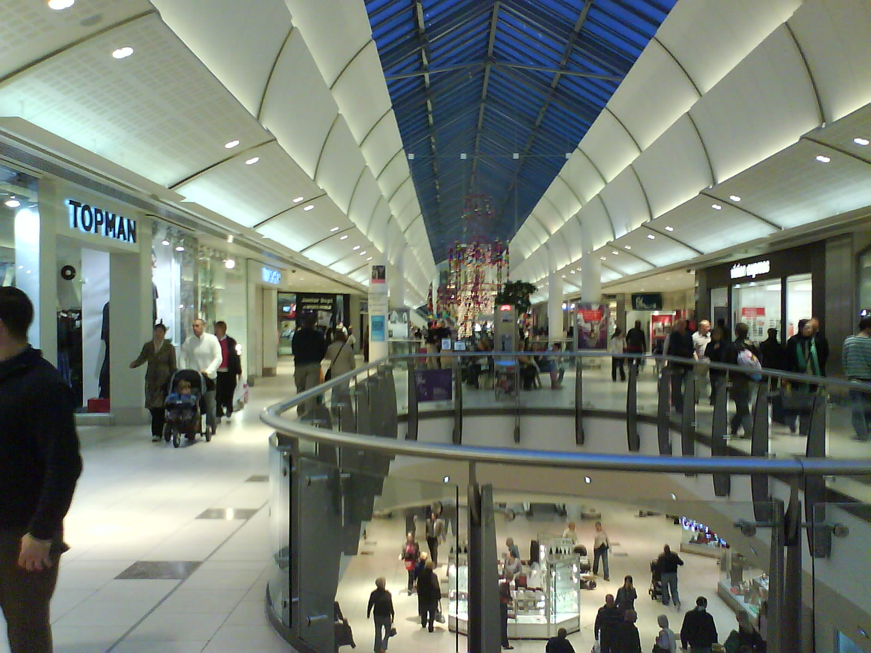
Notes:
This is Lakeside shopping centre outside London. It is a monopoly masquerading as a market. Most of the shops in this photograph (BHS, Miss Selfridge. Top Man, Top Shop, Wallis, Dorothy Perkins) are owned by one corporate group.
This position is typically achieved through leverage (borrow at x% interest, invest at x + y % return on assets). Under this system, the incentive is for businesses to grow large, because every extra unit of money borrowed produces an extra unit of net profit. Leverage becomes much more common where the banking system is capable of expanding money supply using the fractional reserve system.
If the banking system favours any one group of businessmen (for whatever reason) it can empower this group over others by making capital available to it. If this occurs early in the economic cycle, the favoured group can buy up assets and opportunities at low prices. The banking sector will naturally tend to favour groups who support its political objectives.
These political aspects combine with the commercial logic of leverage to increase business concentration. A few very large firms have begun to dominate economic activity. Owner managers are declining in number, and low wage employees have become commonplace. Banks and corporate shareholders tend to benefit from this framework of business and finance. Social cohesion, competition, product quality, and the built environment tend to suffer.

Slide 7
Debt-free Home Finance
80,000
20,000
Home Finance Provider
Home Buyer
Rent and purchase payments
Subscriptions
Distributions
Investors
title
100,000
Developer
Notes:
Home finance can be arranged without debt or interest. Here there is a partnership in ownership between the finance company and the home buyer. There is no debt. The home value can fall to £0 and the finance company will therefore own 80% of £0. There will be no negative equity for the homeowner.
Over time, the homeowner can buy the share of the finance company at market value and become 100% owner. Meantime, he rents the portion that he does not own until the end of the contract. At this point the home is either owned 100% by the homeowner, or it is sold on the open market and the proceeds are distributed according to the ownership shares.
This model has been implemented in the United Kingdom.

Slide 8
Toll-road BOT
Road users
Contractors
Turnkey delivery
Toll payments
Milestone payments
SPV
Operator
Management agreement
Subscriptions
Distributions
Transfer of title at end of concession
Sponsor
Investors
Notes:
Investors buy sukuk in an SPV established to develop a build-operate-transfer toll-road. The SPV invests the funds into a turnkey toll-road construction project. An operator is appointed to manage the toll-road during the construction phase. Road users pay tolls to the SPV and these are distributed to the sukuk holders. At the end of the concession period, the toll-road is transferred to the ownership of the state.
This financing technique genuinely shares risk and reward between the project stakeholders. Investment decisions are made on the basis of project viability, not collateral. Financing costs are determined by project performance, not a pre-defined rate of interest. This form of financing serves to remove conflicts of interest and improves resource allocation in the economy, since investors face the consequences of their own investment decisions.
The sukuk could be listed, and one or more banks could be appointed as market-makers. This will provide liquidity to investment institutions who hold the sukuk as part of their asset portfolio.

Slide 9
Capital Equipment Leasing
Client
Equipment Supplier
Lease contract
Title to equipment
Rental payments
Purchase price
SPV
Agent
Service agreement
Subscriptions
Distributions
Sale of equipment at end of lease period
Investors
Third Party
Notes:
With a few minor modifications, the toll-road financing model can be adapted to meet many other financing needs. Above is an operating lease in which residual value risk is taken by the sukuk investors. The client pays rent on the equipment and this provides the return to the sukuk holders. At the end of the period, the equipment is sold on the second hand market and the sale proceeds determine the redemption value of the sukuk.
In developing countries, an agent could be financed on a profit and loss sharing basis by investors to purchase capital equipment for rental or instalment sale to local customers. Being familiar with the local environment, the agent will administer the acquisition and rental/sale activity according to the terms of its agreement with the SPV.

Slide 10
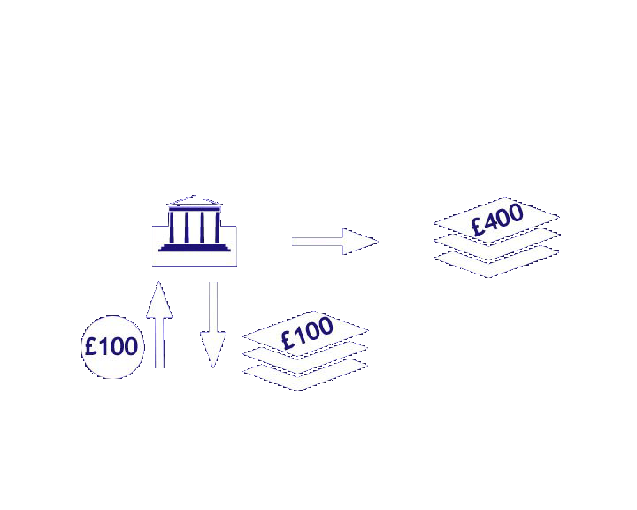
Notes:
One of the most important macro-economic consequences of interest is that it makes fractional reserve banking profitable. Historically speaking, banks started off by taking deposits of gold or silver coins and giving depositary receipts in return. The banks wanted the right to lend out the gold in their vaults, but since these belonged to customers, such activity was widely seen as illegal.
In 1848, in the case of Foley versus Hill in England, it was judged that the deposit of coinage in a bank is not a bailment (in which the coins continue to belong to the depositor and the bank is merely a safe-keeper) but instead a loan of money to the bank. This was the case only in banking, and not for example in the storage of wheat or other commodities in a warehouse. The Foley versus Hill decision allowed the banks to lend the gold stored in the vaults, since the ownership of loaned money is seen as being with the borrower not the lender.
Meanwhile, bank customers had adopted the habit of paying for their purchases using bank receipts. This allowed the banks to begin making loans of paper receipts which they created at little or no cost in their printing rooms.

Slide 11
Notes:
Here the bank has loaned £400 of newly printed paper receipts at interest. But what is the legal basis for creating a total of 500 claims of ownership on the same 100 gold coins? If a house-builder sold one house five times over (using different sets of title deeds) we would call it fraud. If the monetary system is based upon an act of fraud, then every other system in which money is used will be undermined in some way.
The economic consequences of money creation by the banking system are several. The more money that banks create, the more they can lend and the more interest they can earn. They are therefore under an incentive to increase the amount of created money over time. But as this new money is spent by borrowers, the price level within the economy begins to increase. This is particularly obvious when banks target their lending to one particular sector of the economy, for example real estate. Conversely, when the banking system reduces its lending, prices and business activity can fall. Booms and busts therefore tend to become more marked under this kind of monetary system.
The lack of debate about the nature of money in the Islamic banking community is a serious omission. Some Muslim scholars are unaware that Islamic banks practice money creation. The common argument of many Islamic bankers is that they “only finance real assets” but this does not change the fact that such financing uses money created out of nothing by the bank. Boom and bust is therefore as likely under the Islamic banking framework as it is under the secular banking framework.

Slide 12
BANK
cash £10
£ 10 equity
PERSON A
PERSON B
Notes:
In modern times, commercial banks no longer issue paper receipts. A system of accounts and credit money is used instead. Here, a bank is established using £10 of shareholders’ cash capital. The first two customers join the bank and each opens a current account. They have no money in their accounts at this stage. The balance sheet of the bank appears as above.

Slide 13
BANK
cash £10
£ 10 equity
PERSON A
PERSON B
loan £ 100
£100 money
Notes:
Person A pays a cheque of £100 to person B for a purchase agreed between them. Person B deposits the cheque in the bank and the bank debits A and credits B. £100 of new money has appeared in B’s account and A is now in overdraft by £100. The bank allows this to happen because it can charge interest to person A, but the bank has not used any of its cash in the process of making this loan to A. It is merely a computer based entry in the bank’s accounting system. Notice that if B asks the bank to pay him cash over the counter, then the bank cannot do so since it has only a 10% cash reserve (in other words, the bank is operating a fractional reserve).
Bank runs occur when depositors become fearful that a bank will not have sufficient cash to redeem deposits when requested. Such a fear is justified, because under the fractional reserve system, a commercial bank is never in a position to redeem all of its deposits. Hence, much effort is undertaken by government and the banking industry to “maintain confidence” in the banking system.

Slide 14
Turkey CPI and M2 (% annual change)
Notes:
In Turkey, as in other countries operating a fractional reserve banking system, the change in the rate of money expansion correlates closely with the change in the rate of inflation.

Slide 15
UK Home Prices and Lending (% annual change)
Notes:
In the UK, as in other countries, the change in the rate of lending for home purchase correlates closely with the change in the rate of home price inflation. Here, an attempt is made to show the rate of change of the net flow of funds into and out of the home finance market. To do this, the amount of net lending into the housing market is first calculated for each year. Net lending is the amount of new loans made to bank customers less repayments of existing loans to banks. The figure for net lending is then adjusted by the amount of interest charged on outstanding housing loans for the year. The resulting figure is the net flow of funds into or out of the housing market. The change in this net flow of funds is compared to the change in house prices in the above graph.

Slide 16
Transition to an Interest-free Money Supply (1)
Implement programme of public education on need for reform
Separation of current accounts from risk-bearing investment accounts
Establishment of a state-funded bank lending on an interest-free basis
Adopt defensive restrictions on foreign capital movement
Imposition of maximum rate of interest, gradual reduction over time
Increase in M0 through government debt buy-back with simultaneous increases in statutory reserve ratios
Encourage use of capital risk sharing products in investment accounts
Gradual increase in backing of M0 with selected real assets
Notes:
The above steps are proposed as key elements in the transition from fractional reserve banking to 100% reserve banking. The transition offers a quick win to government since it allows repayment of a substantial portion of government domestic debt at no cost.
The premise of the reform is that if the commercial banking system can create money and lend it at interest, then the government has at least an equal right to create money and lend it at 0% interest. In this reform, the government creates sufficient money to repay the government debts that are held by the banking system. The money thus created by the state is thereafter held by the banks as reserves against their existing deposits. The government will require that the banks hold these increased reserves by raising the statutory reserve ratio.
An independent institution could be created to monitor money creation by the state, and restrict it to agreed amounts. Or, the monetary base could be converted to a commodity such as gold, thus removing the right to create money from both private and public institutions.
A state institution that lends interest-free will be established at the outset to assist private and public sector borrowers during the transition phase. Commercial organisations may be unwilling or unable to lend during this phase, and such an institution will therefore act as a safeguard against economic instability while the above reforms are taking place.

Slide 17
Transition to an Interest-free Money Supply (2)
 | Existing | Reform1 | Reform 2
Bank assets
Cash | 10 | 60 | 60
Loans to public sector | 50 | 0 | 0
Loans to private sector | 40 | 40 | 0
Total | 100 | 100 | 60
Bank liabilities
Owners’ equity | 10 | 10 | 10
Deposits | 90 | 90 | 50
Total | 100 | 100 | 60
Notes:
The “Existing” column shows the banking sector balance sheet under the present fractional reserve system. The banking sector has made loans to both government and private enterprises, and these loans are the major part of banks assets. The remaining asset is cash. Here the cash reserve ratio is 10%.
The “Reform 1” column shows that the government has created 50 of money and used this to buy back the public debts held by the banks. The banks now have a 60% cash reserve ratio and are no longer earning interest from the government.
The “Reform 2” column shows that the private sector debts have been removed from the balance sheet. These have been transferred to investment institutions which offer profit and loss sharing finance to the private sector. From now on the banking sector operates current accounts only, including payment transmission services. It may charge for such services. It is a 100% reserve banking system and can no longer create money.

Slide 18
A New Institutional Framework
100% Sight Deposit Banks
Public Sector Monetary Trust
Individuals
Corporations
Government
Investment Institutions
Public Sector Welfare Trust
Notes:
The new institutional framework now looks as shown above.
Current accounts have been separated from investment accounts, so that investors wishing to earn a return must hold their savings in investment accounts from which withdrawal will only be possible if the investing institution is sufficiently liquid. Current accounts operate as safety deposits under the contract of bailment, hence banks will not be permitted to lend or otherwise invest amounts deposited in current accounts.
Notice that there is a public sector monetary trust acting as an independent organ of state to oversee money creation according to agreed and transparent rules. In a commodity money system, this institution would act mostly as an auditor of commodity money quality standards, and ensure adherence to the statutory requirements acting upon monetary institutions.
A welfare trust is also proposed to assist in a variety of functions which are deemed to be of benefit to the wider society. These might include the guaranteeing of trade credits between sellers and their customers in the retail sector. For example, instead of borrowing money from a bank in order to buy a washing machine, a customer could pay instalments directly to the seller and these instalments would be guaranteed by the welfare trust. In this way, the financing of consumer goods purchases could continue largely unaffected by the likely reduction in availability of financing from the banking sector. The welfare trust might also encourage and develop the gift economy, by means of financial support and other assistance to new businesses and younger entrepreneurs at critical phases in their development.

Slide 19
Cost of Bank Bail-outs as % of GNP
Country | % of GNP
Sweden 1992-96 | 3.6
Spain 1977-85 | 16.8
Venezuela 1994-5 | 18
Mexico 1994 | 19.3
Japan 1997 | 24
Chile 1981-83 | 41.2
Thailand 1997-2000 | 45
Malaysia 1997-2000 | 45
Argentina 1980-82 | 55.3
South Korea 1997-2000 | 60
Sources: B. Lietaer from The Economist 27/9/2008, Working Papers no.1620 World Bank 1996
Notes:
Some economists have argued that the use of gold (or commodity money generally) is inefficient, but the cost of rectifying the banking crisis in south Korea was greater than the annual output of the entire global gold mining industry! We should look seriously at the costs and benefits of a commodity money system, and we should compare these costs to what is presently being paid in rescuing the existing monetary system.

